Slide 1
The AIAA “Flight Mechanics
Model Exchange Standard”
Tutorial
Bruce L. Hildreth
Chairman – Simulation Standards Subcommittee
SAIC Technical Fellow for Flight Simulation
SAIC/Simulation and Research Services Division
22299 Exploration Drive, Suite 200
Lexington Park, MD 20653
301-866-6701, FAX 301-863-0299
EMAIL: Bruce.Hildreth@saic.com
http://daveml.nasa.gov

Slide 2
Tutorial 1- “Introduction”
or
“why do we need a stupid standard anyway, I want to do things MY way”

Slide 3
Outline
Need for the Standard
Method of Developing the Standard
Present Status of the Standard
Work Required to Complete the Standard

Slide 4
Outline
Need for the Standard
  Present Lack of Cohesive Standard for Math Models
  Some Parts of Modeling Standards Exist
  Definition of the Problem that the Proposed Standard will Address
Method of Developing the Standard
Present Status of the Standard
Work Required to Complete the Standard

Slide 5
Introduction
There are no meaningful simulation math modeling standards including:
• Models specific to a vehicle
• Model non-specific to a vehicle
• Functional data
• Validation data
• Formats for exchange of models / data
The AIAA Modeling and Simulation (formerly named Flight Simulation) Technical Committee is proposing to solve this problem by the development of Nationwide Flight Simulation Dynamics Modeling Standards
PRESENT EMPHASIS ON DYNAMIC MODELS

Slide 6
Background: the Need for Simulation Standards
Reliance upon simulation has been growing due to accelerating aircraft program costs, safety advantages and exploding simulation technology
Historically government, industry simulation facilities have developed separate, dissimilar hardware / software architectures using multiple host computers
  Emphasis has always been on hardware; software written as needed using different languages
  Few standards have been proposed to facilitate the re-use of simulation models
DOD draw downs have increased the importance of teaming arrangements in the use of simulation to support the acquisition process
  These teaming arrangements require simulation data exchanges in the absence of any meaningful simulation standards
Rehosting of flight dynamic models is tedious, labor-intensive, error-prone, and inefficient without standards

Slide 7
Benefits of Adopting Nationwide Simulation Standards
Reuse of Simulation Model Software Results in:
Certify and validate once
Order of magnitude increase in productivity
Models easier to exchange between
facilities and organizations
Test results easier to exchange
Able to have standard models
Increase confidence in simulation
predictions
Improve configuration control
Representative Simulation Station
AYK-14 Misson Computers
VAX 11/780 - Tactical Environment
Flight Control Computers
VAX 11/780 - Avionics Models
VAX 8650 - Aero, Engine &
Landing Gear
ADI System 100
Equations of Motion
COMPUSCENE IV
1553 Bus
Image Generator
Multiported
Instructor / Operator
Memory
Station
Cockpit
Virtual Image Display
Enclosure
μ
Motion Platform
VAX 2

Slide 8
Simple Example of the Need
Reduction in the Duplicated Effort in the F-18 Simulations (and the F-18 Simulations coordinate more than most)
Different F-18 Simulations
  NAWCAD Pax. River
  NASA Langley
  NASA Dryden
  NASA Ames
  F-18 WST (Several locations)
  F-18 OFT (Several locations)
  Boeing Simulations (several)
  Virginia Tech
NC State Univ.
West Va. Univ.
SAIC
Bihrle Applied Research
Royal Canadian Air Force
Royal Australian Air Force
other Foreign Military
In 2002- Over 60 simulations at 20 sites

Slide 9
Summary of the Problem
• No Standards Exist for Modeling the Vehicle Dynamics
  There are Some Standards that Partially Apply
    HLA/DIS and AIAA Axis Systems
Significant Potential for Savings Throughout the Industry

Slide 10
Outline
Need for the Standard
Method of Developing the Standard
  AIAA Modeling and Simulation Committee Developing and Executing the Method
  Based on Physics and S/W Development Practices
  Maximum Utilization of Existing Standards
Present Status of the Standard
Work Required to Complete the Standard

Slide 11
Standardization is Simple ?
Standardization is relatively simple for a well defined physical system such as dynamic vehicle simulation
Well defined:
1) Physics of Motion
2) Earth Models
3) Atmosphere Models
4) System Performance Requirements

Slide 12
Simulation Standards Development Road Map
Standard Soft-
May not want to do
ware Modules
Module
Functionality
Testing and
Validation Methods
Increasing
Standardization
Axis System
Definitions
Common
Databases
Phase I
Common
Variables
Standard Model
Interchange Format
Each Level Builds Upon the Other

Slide 13
Solution- An exchange standard
Simulator Site A
(for example-
a training simulator site)
Simulator Site B
(for example-
an R&D simulator site)
Import/Export
Tools
The Standard,
DAVE-ML
Import/Export
Tools
Only need to build the import/export tools once!
Import/Export
Tools
Simulator Site C
(for example-
an engineering simulator site)
Does not impact a simulation architecture

Slide 14

Phase I Standard Level:
Common Variables
Standardize on Variable Names and Definitions:
• Include
• Name
• Units
• Sign Convention
• Description
• References
• Example:
• anglOfAttack_d
• degrees
• + nose up
• Fuselage angle of attack
Projector
#1
AOI
Projector
#2
Equatorial
line
Cockpit
SIMULATOR COCKPIT
AND
GENERAL PROJECTOR
LOCATIONS
Required for clear info transfer between simulations

Slide 15
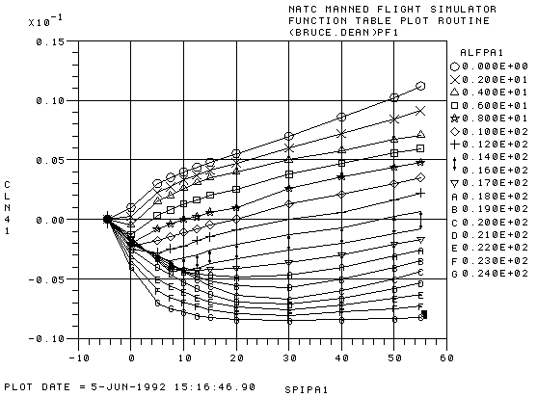
Phase I Standard Level:
Common Database
Standardize on Databases Used in SIMULATIONS
• Function Tables
• Time History Data
• Navigation Aids
• NOT Visual Databases (another standard)
Symmetric Stab
Differential Stab
Rudder Deflection
δ
Cl
δ
Cm
δ
Cn
δ
CL
δ
CD
δ
CY

Slide 16
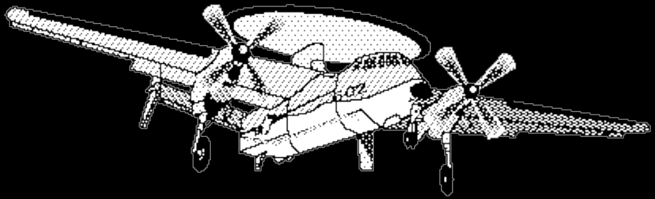
Phase I Standard Level:
Axis System Definitions
Further Clarifies Variable Name Definitions
Standard already exists (ANSI/AIAA R-004-1992) and DIS/HLA
+y
+x
Required for clear info transfer between simulations
+z

Slide 17
Conclusions
Insufficient math modeling standards exist
There is a logical path for developing standards
Simulation modeling standards would be valuable contribution to American aerospace industry
Proposed Solution
• Develop Standards Using AIAA Input
• AIAA Modeling and Simulation Technical
Committee Review Standards
• AIAA Issue an ANSI Standard
Endorsed by DMSO, FAA and Industry
• Start with standard for data exchange

